Slide 1
121 analysis labs
PSYC121
Week 4, Term 1

Slide 2
Pre-lab & lab tasks
Class test
A few words
Pre-lab
Learnr as usual
Tasks
R studio; customization of graphs
calculating z-scores & percentages
applying z-scores to worked problems

Slide 3
Class test
Scheduled in Analysis lab slot
Approx 50 mins long
Clock starts when you do
Not a speed test (in our experience, majority of students finish before time is up)
Don’t leave until the test is over
Randomised questions, randomised order
Covers all of PSYC121, week 1-4
University-wide module expectations (mean mark 55-65%)
Previous years: week 5 class test outperforms this

Slide 4
More on graphs ….

Slide 5
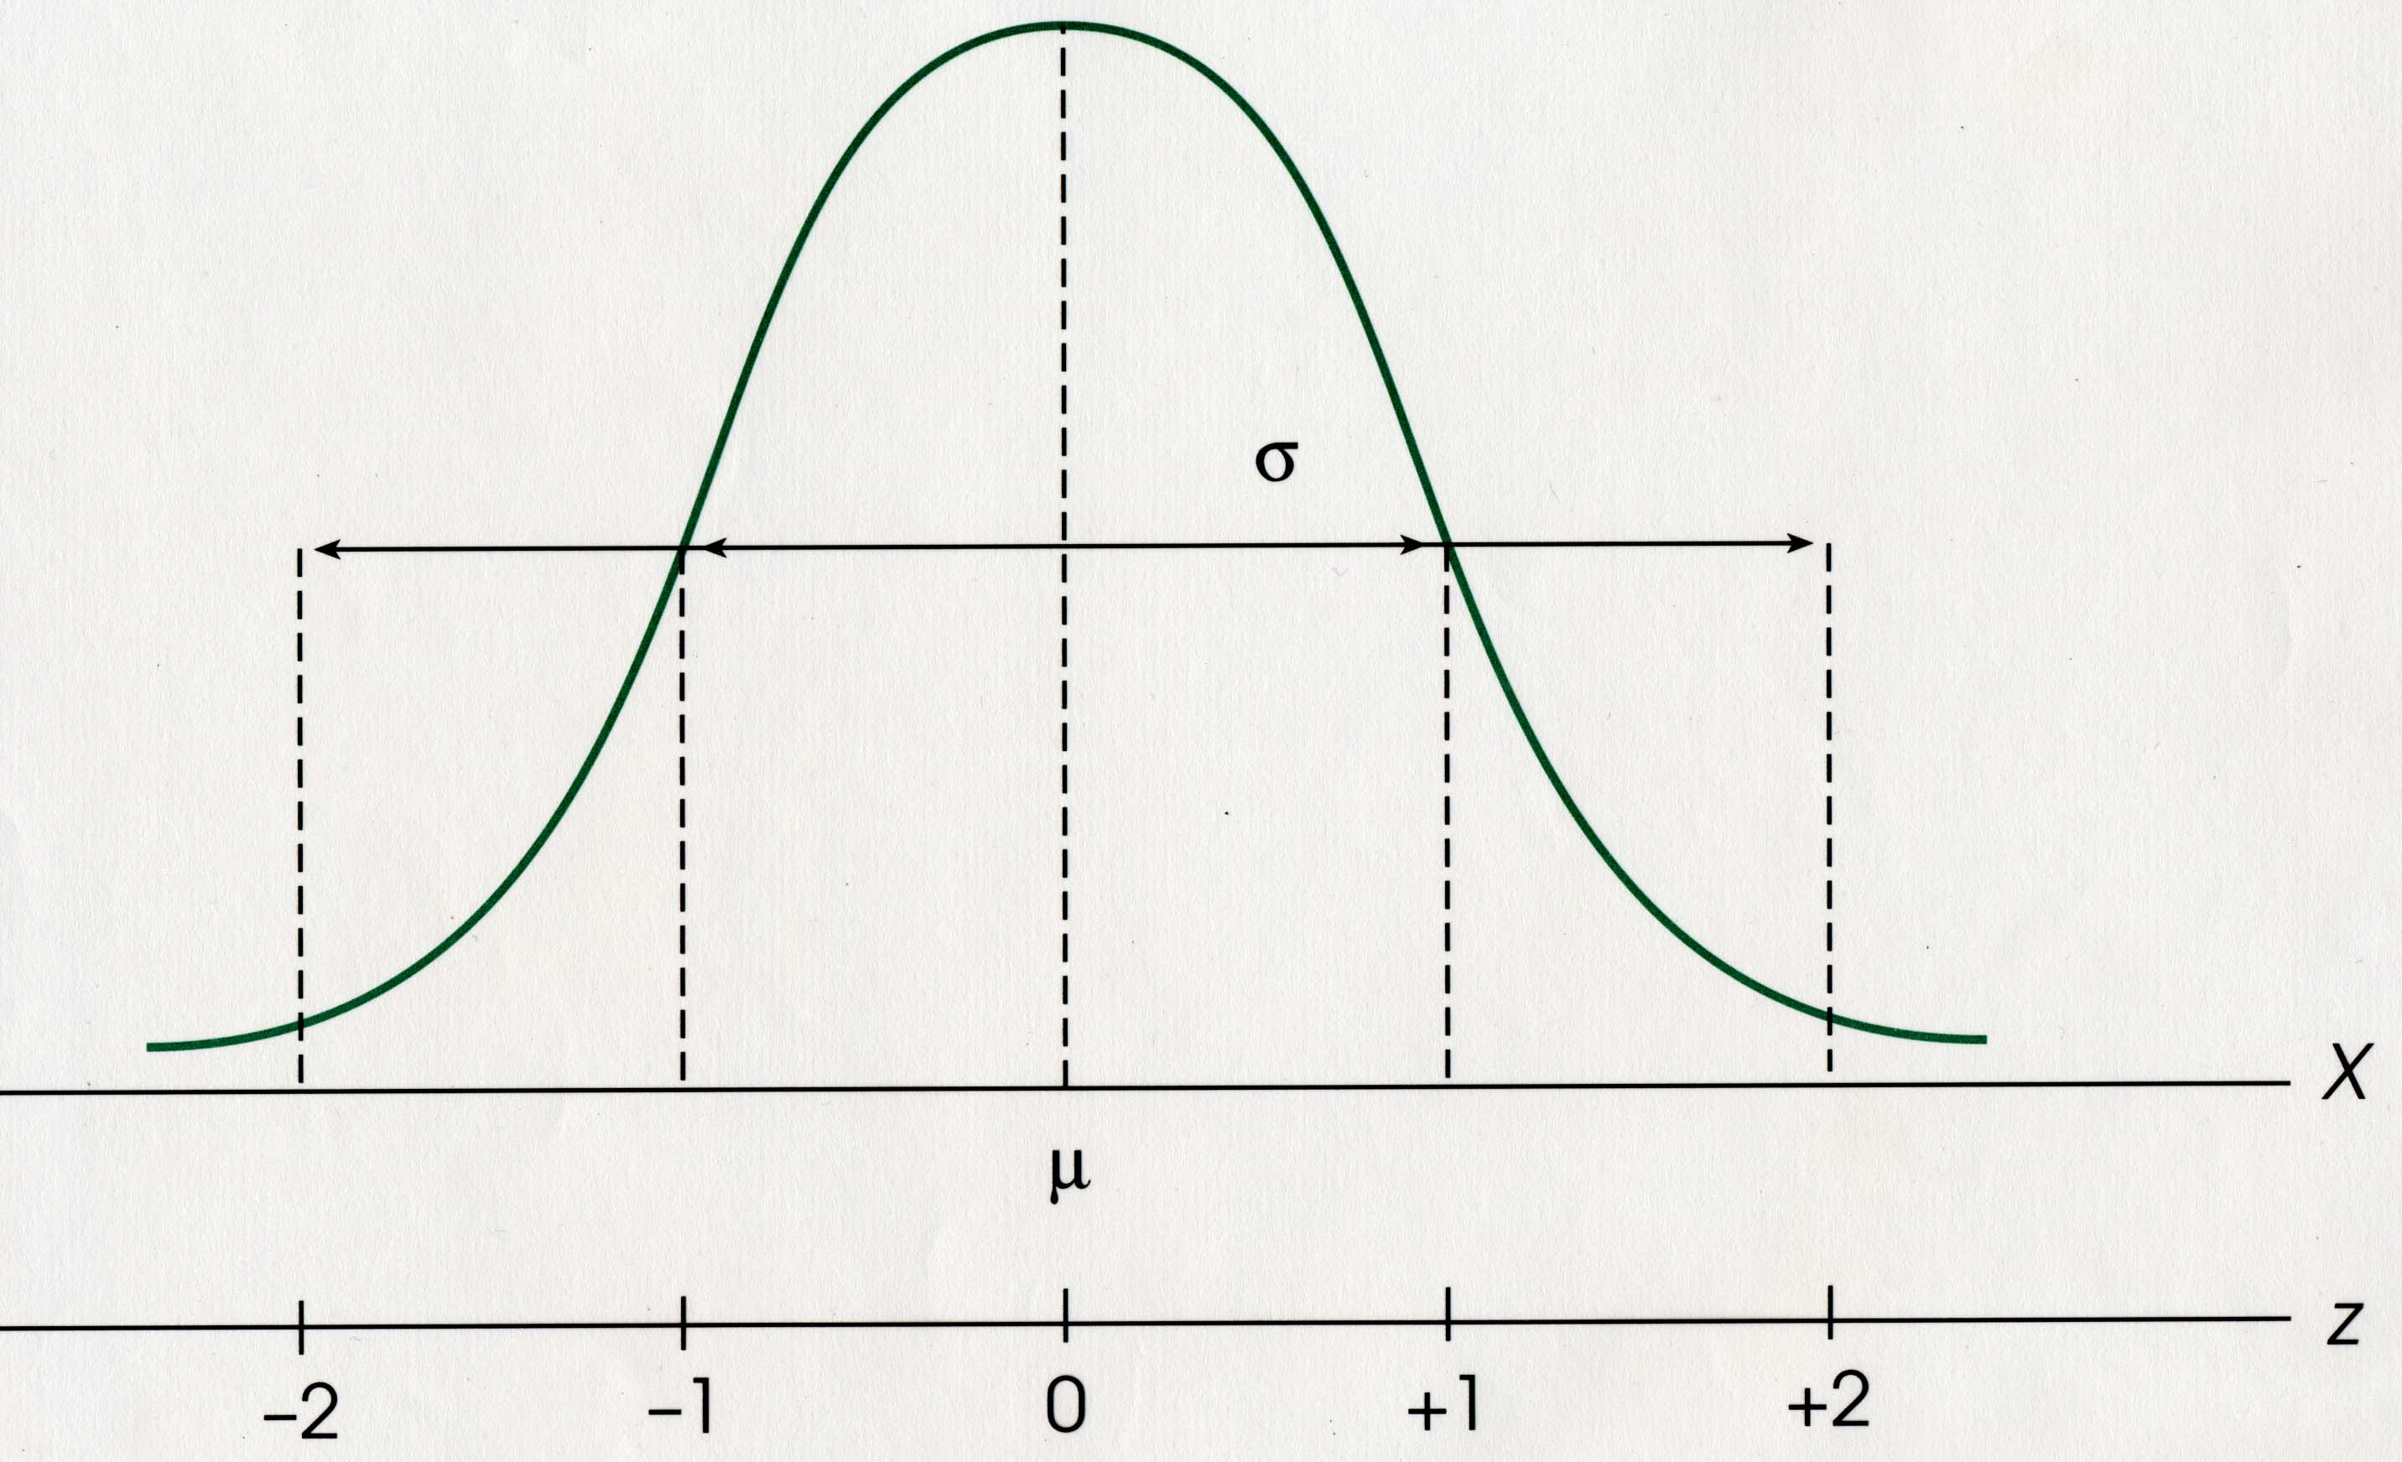
sketch

Slide 6
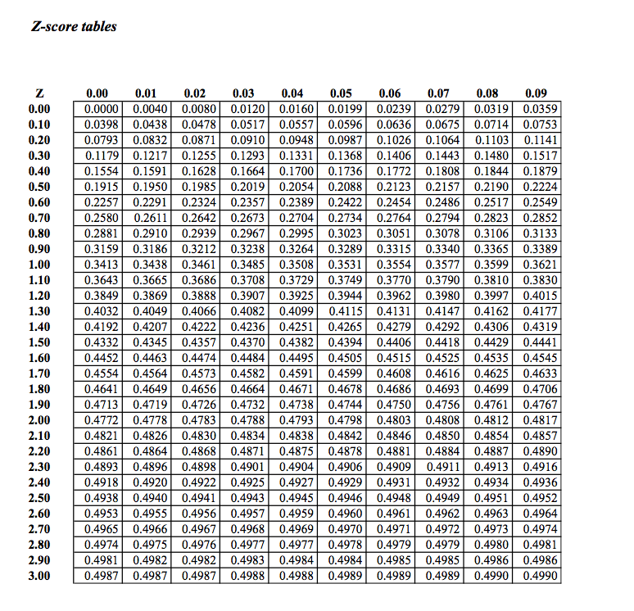
Z-score table

Slide 7
Think about probabilities and likelihood
A pack of cards …..
Are the next 2 cards RED or BLACK?
Are the next 2 cards Diamonds, Hearts, Clubs or Spades?
What precisely are the next 2 cards?

Slide 8

Type 1 & Type 2 errors

